Slide 1


Group w NYC taxi data
Jae Ham & Andrew Thvedt

Slide 2
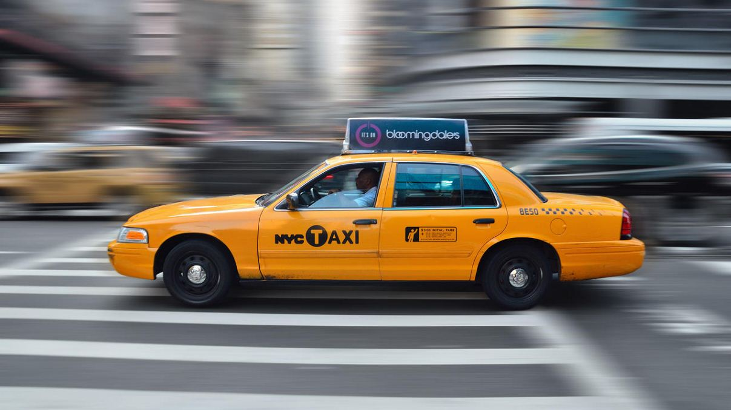
Project Rationale
NYC Yellow Cab 2019 Data
Derived from TLC Website
Exclusive focus on yellow cabs
Year 2019
Preprocessing Data Steps
Stage 1
Subsetting Data
Stage 2
Scrubbing Data
Stage 3
Final Processing
100,000 data points per month
Rate Code ID
Passenger Counts
Fare Amount
Fare By Distance
Avg MPH
Dealing with time data
Negative or infinity values
Quality Check

Slide 3
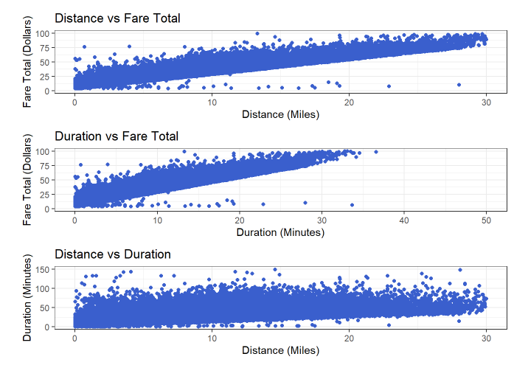
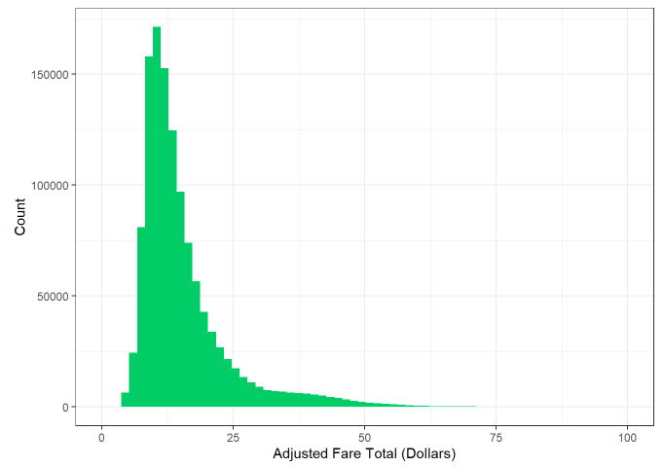
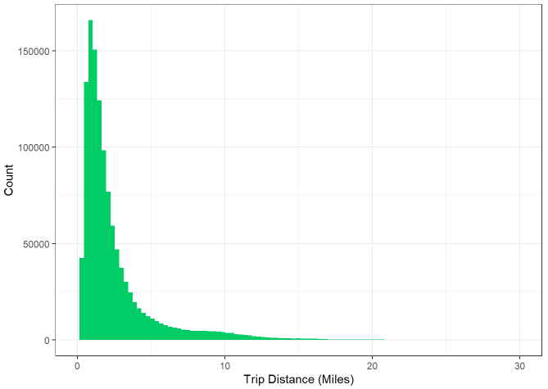
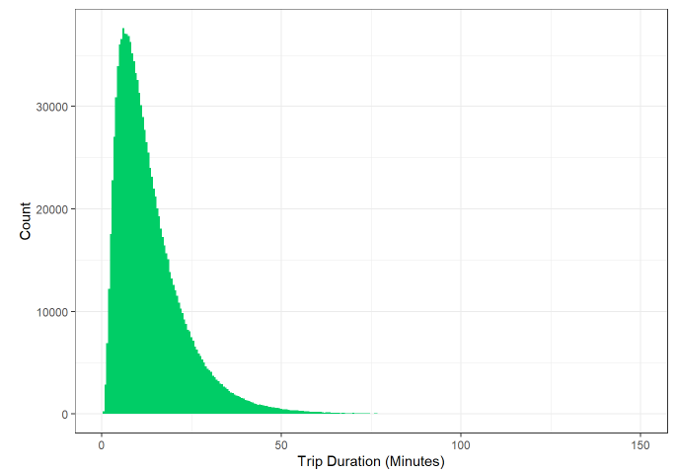
Exploratory Data Analysis
Univariate Analysis
Bivariate Analysis

Slide 4
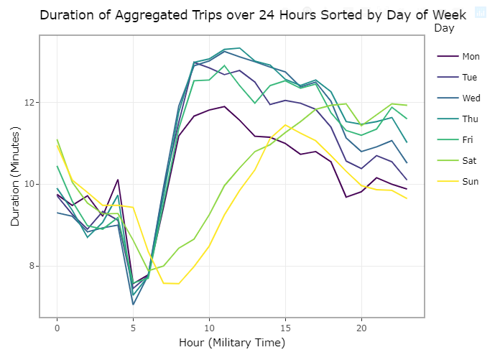
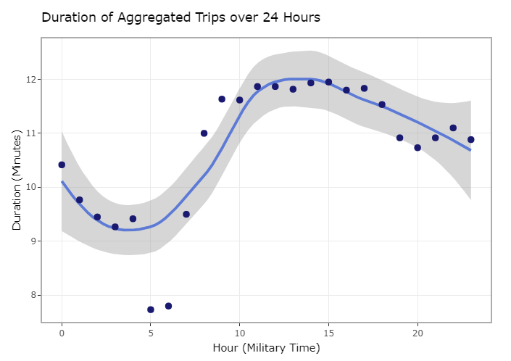
Time Series Analysis

